Slide 1


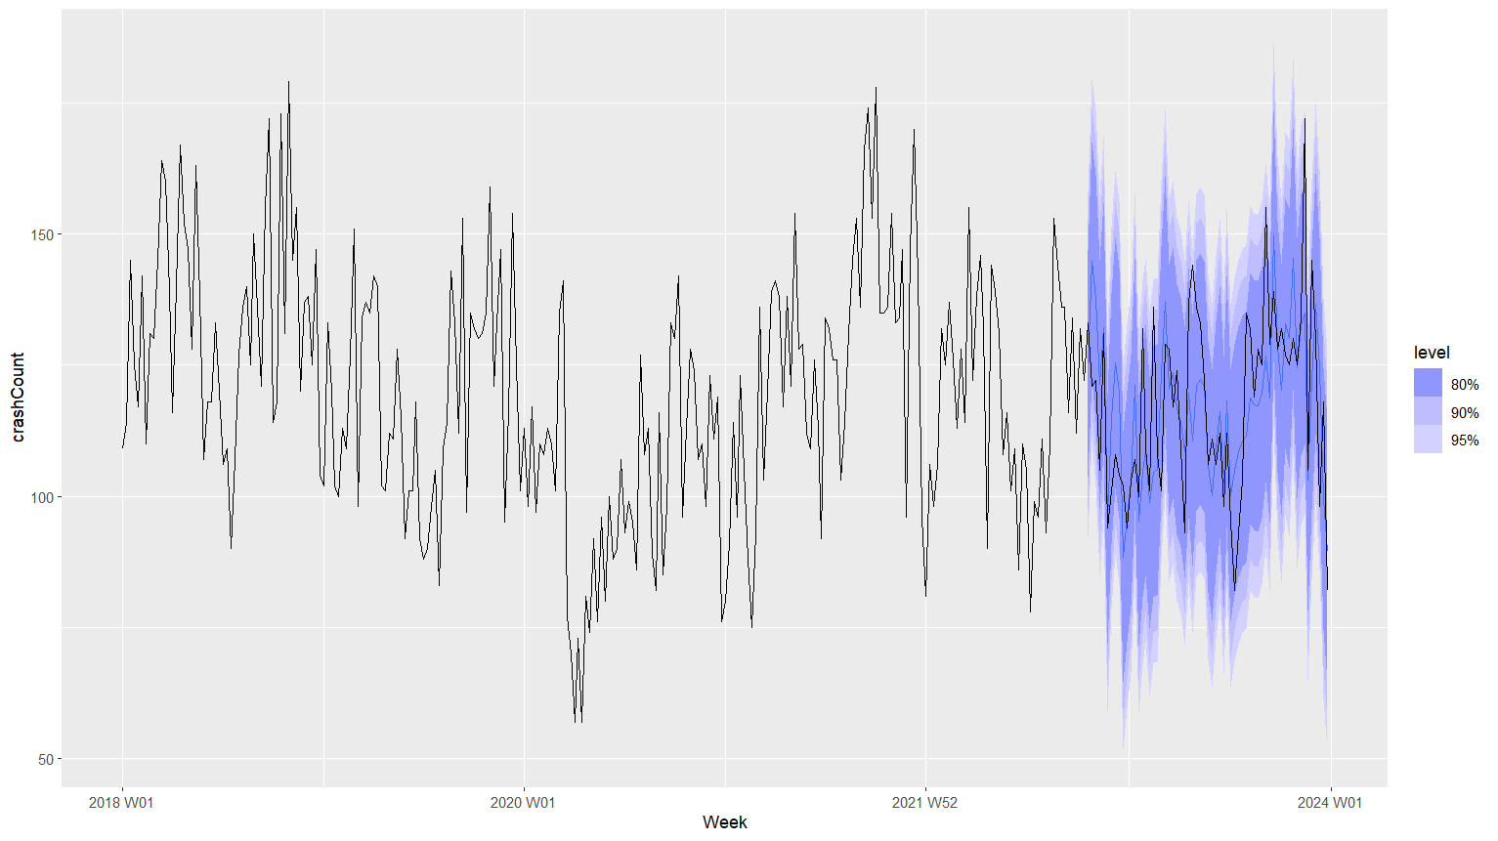
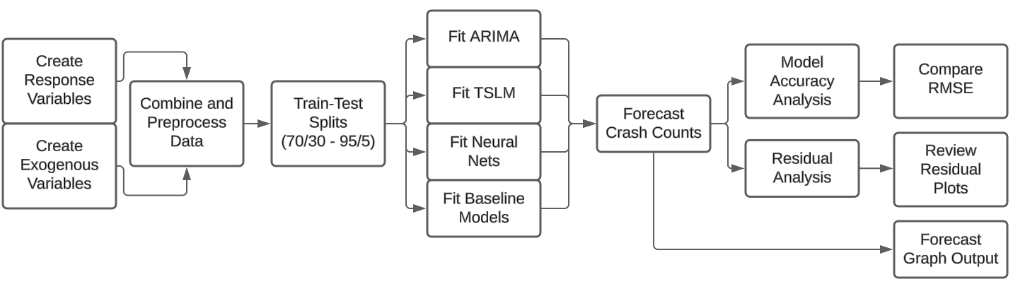
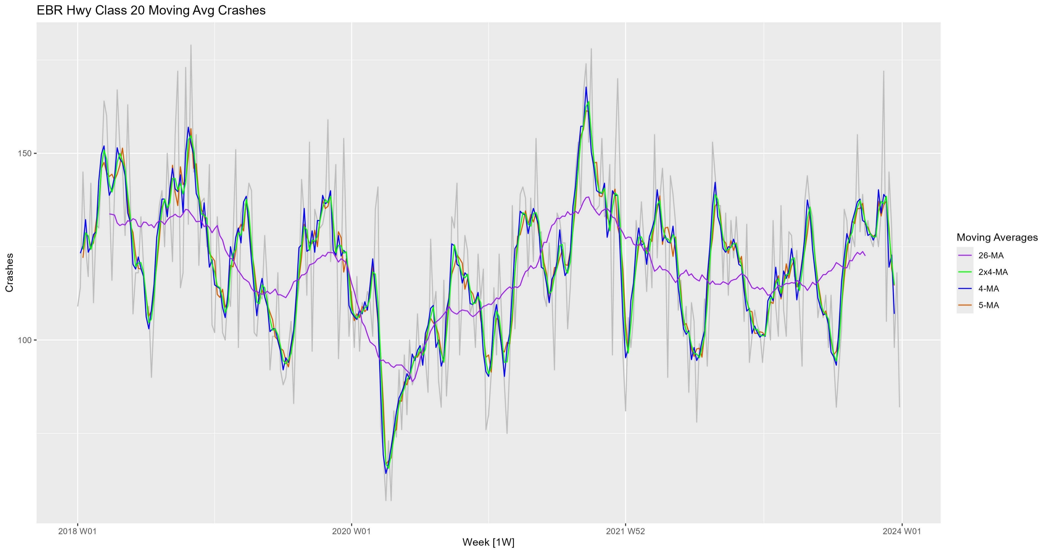
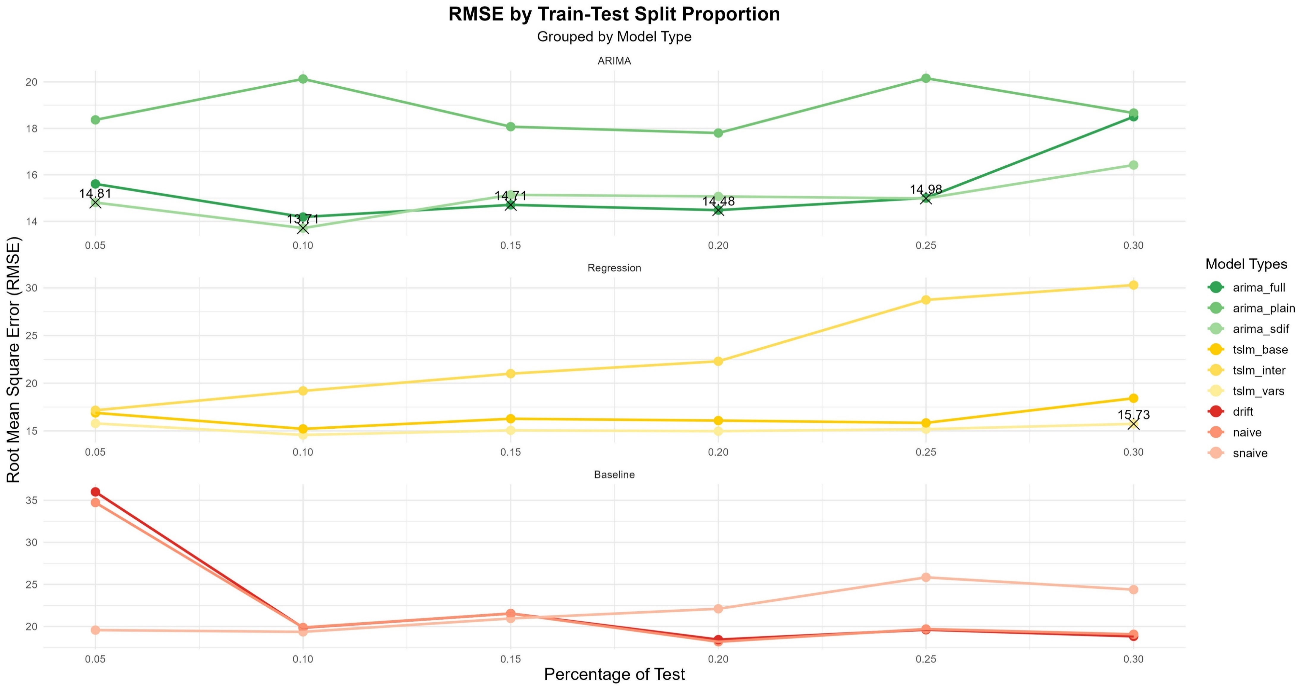
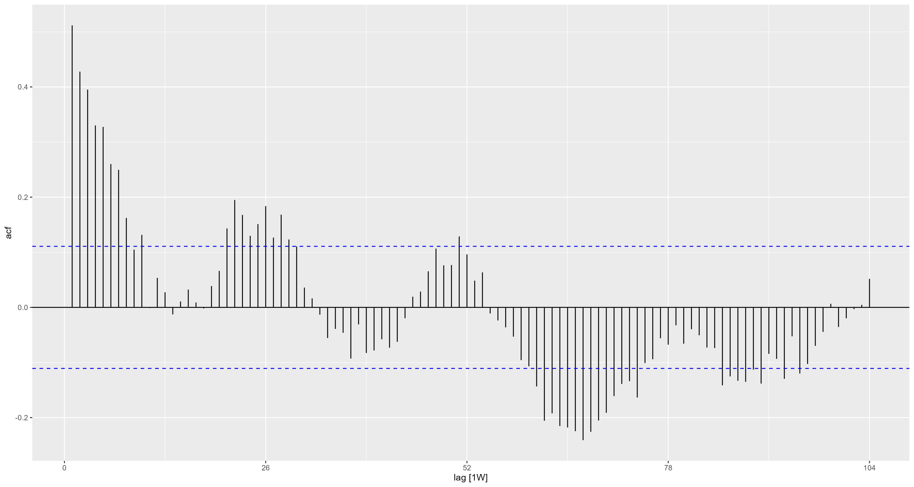
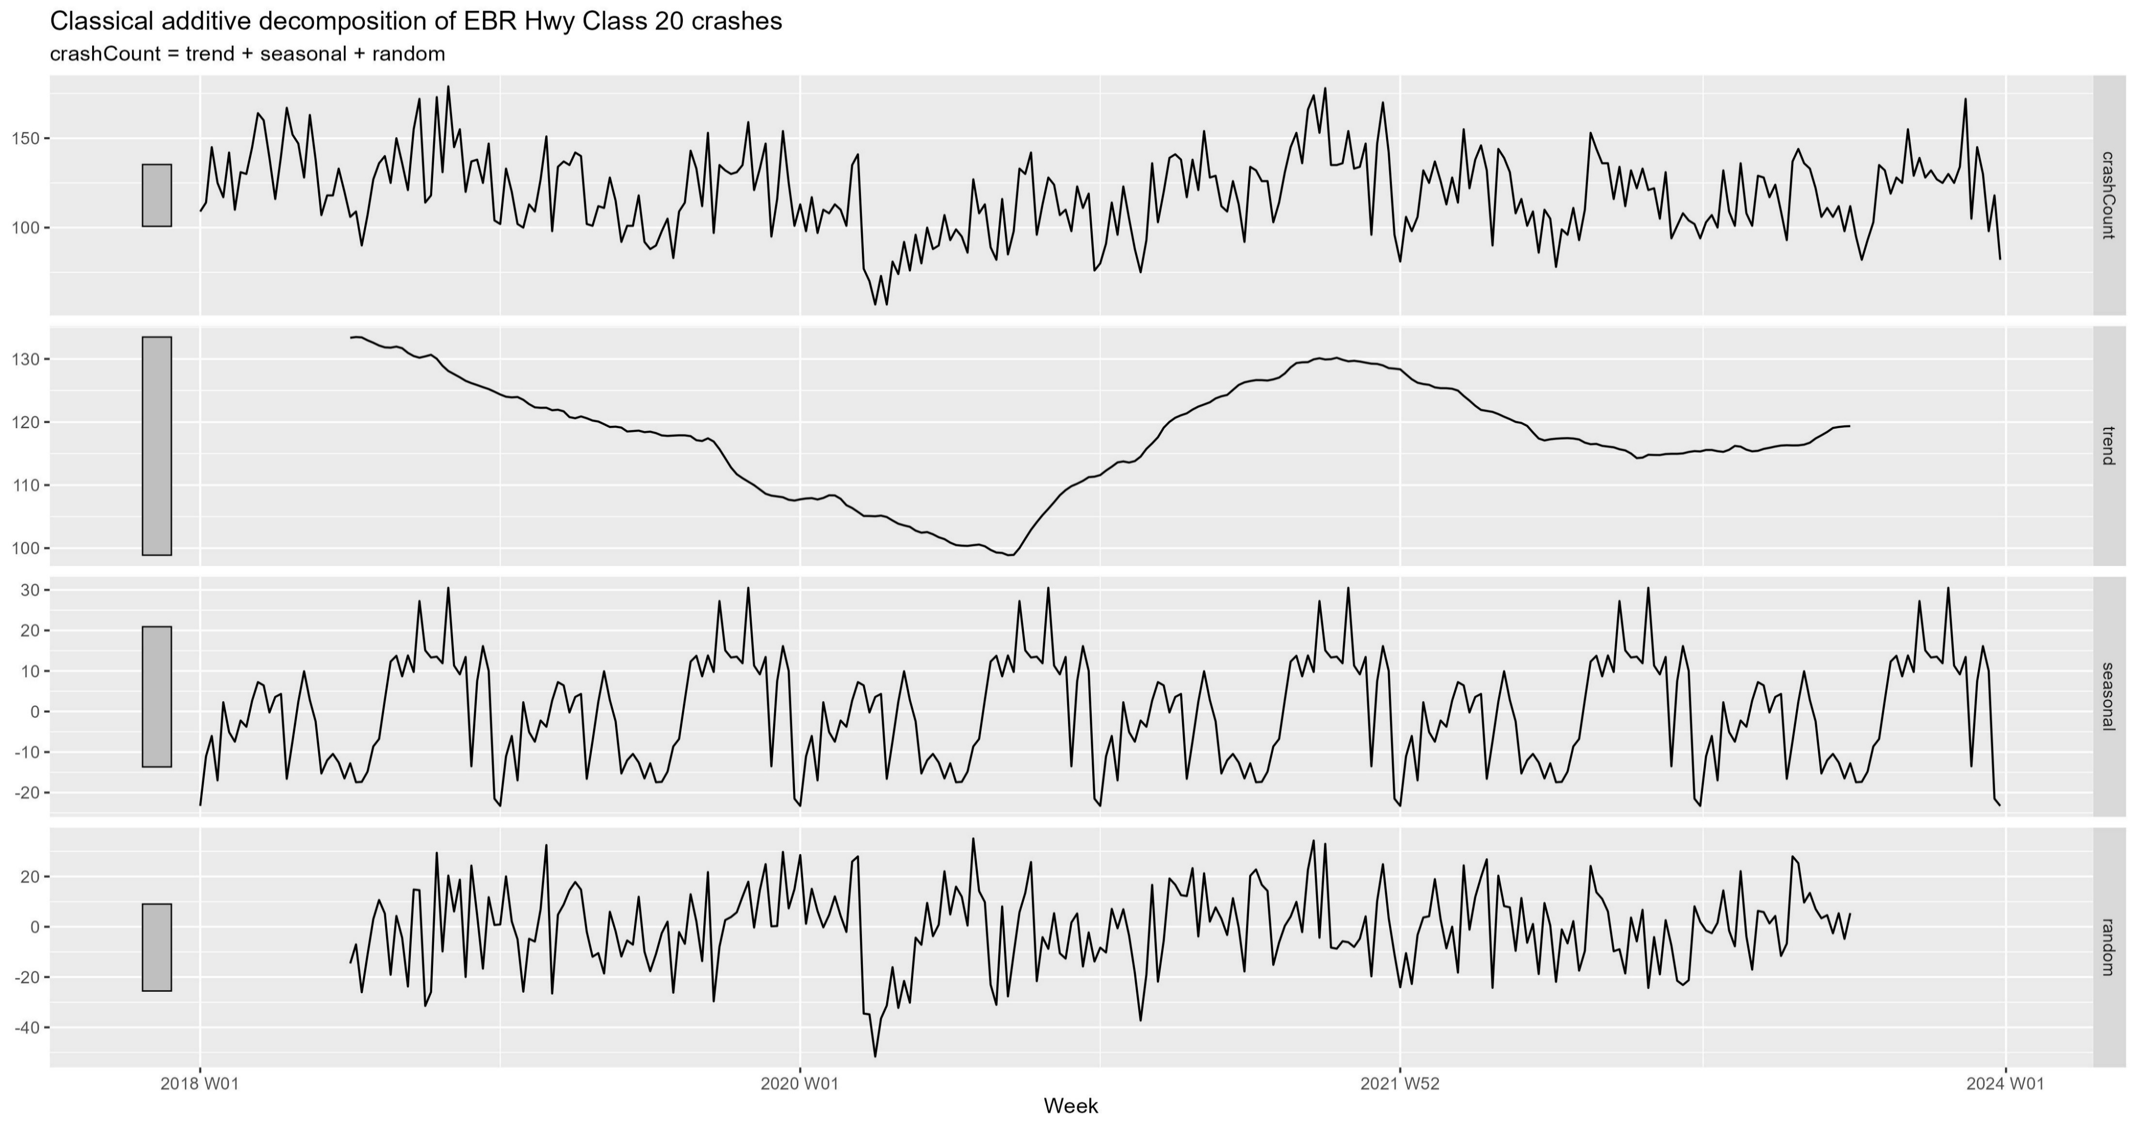

Forecasting Car Crashes on Urban 2-Lane Roads in East Baton Rouge Parish
Michael Allen¹ and Thanos Gentimis²
¹Graduate, Louisiana State University and ²Assistant Professor, Louisiana State University
Objectives
Analysis and Forecast Graphs
Data Analysis
This study aims to compare various models for reliably and accurately forecasting car crashes on urban two-lane roads in East Baton Rouge Parish.
Main Findings
The best model found in this study was an ARIMA model with the raw crash count as response variable and the below listed predictors.
Predictors: Trend component, Seasonal component, LSU Home Football Game, Covid-19 Lockdown, Holidays, and the presence of ice on the roadway.
Results
Motivation
Overall, the ARIMA model containing all the variables performed the best in terms of RMSE and residual analysis.
Many of the denoised models had much lower RMSEs but their residuals had invalidating patterns to them. This presents a possible future area of research.
Car crashes are one of the leading causes of deaths and severe injuries in the United States, resulting in >40,000 deaths in 2022 alone.
Having more accurate knowledge of when crashes may occur will help traffic safety experts more directly address crash patterns.
Figure 2: Forecast of the ARIMA model with all exogenous variables plus trend and season component predictors at the 20% Train-Test Split level. 80%, 90%, and 95% Confidence Regions shown.
Data
The dataset utilized in this study is sourced from the LSU CARTS statewide crash database.
In selecting the data, a balance was maintained between specificity and quantity. The data needed to be specific enough to provide meaningful insights but not so specific that the counts became too small, which would negatively impact model accuracy.
The study utilizes weekly crash counts from 2018 to 2023 for urban two-lane roads in East Baton Rouge Parish.
Additional engineered features considered include COVID-19 lockdowns, LSU football home games, major holidays relevant to East Baton Rouge Parish, and the presence of ice on roadways.
Figure 3: Weekly Crash Count (grey) and Moving Averages using various window sizes. Note the large drop in early 2020. This is due to Covid-19 lockdowns and is one of the things addressed by the binary exogenous variables.
Figure 5: Plot showing performance, via RMSE, of models at different Train-Test Split levels. Neural Nets were excluded from the final output due to long computation times without benefit.
References
Centers for Disease Control and Prevention, National Center for Health Statistics. National Vital Statistics System, Mortality 2018-2022 on CDC WONDER Online Database, released in 2024. Accessed at wonder.cdc.gov
Center for Analytics and Research in Transportation Safety (CARTS) Louisiana State University.
Hyndman, R.J., & Athanasopoulos, G. (2021) Forecasting: principles and practice, 3rd edition, OTexts: Melbourne, Australia. OTexts.com/fpp3. Accessed on December 10, 2024.
Contact
Link to the code and resources for this project.
Figure 1: Autocorrelation Function (ACF) for the Crash Count variable.
Figure 4: Classical Additive Decomposition of the CrashCount variable. Note the plateau with double spike pattern that recurs.
Michael Allen, Data Analytics Manager, Center for Analytics and Research in Transportation Safety, LSU.
Email: malle72@lsu.edu
Thanos Gentimis, Assistant Professor, Experimental Statistics Department, LSU.
Email: TGentimis@agcenter.lsu.edu

